Slide 1
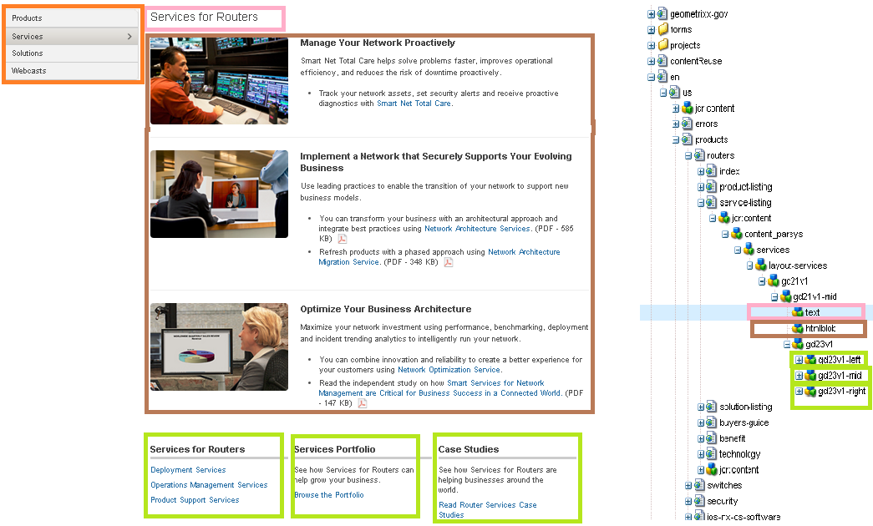
http://www.cisco.com/c/en/us/products/servers-unified-computing/service-listing.html
http://www.cisco.com/c/en/us/products/routers/service-listing.html
http://www.cisco.com/c/en/us/products/switches/service-listing.html
http://www.cisco.com/c/en/us/products/wireless/service-listing.html
http://www.cisco.com/c/en/us/solutions/data-center-virtualization/service-listing.html
http://www.cisco.com/c/en/us/solutions/enterprise-networks/service-listing.html
No HTML deviations in this template

Slide 2
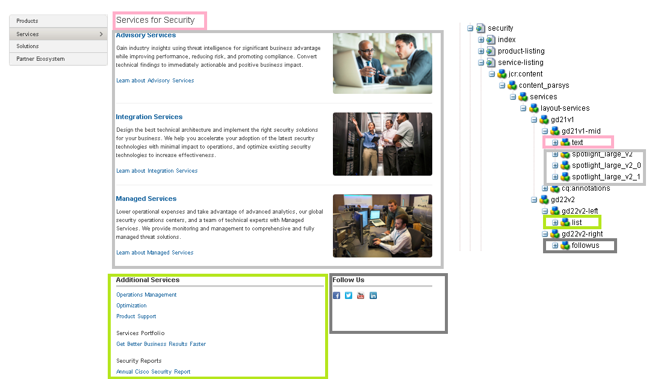
http://www.cisco.com/c/en/us/products/security/service-listing.html
No HTML deviations in this template

Slide 3
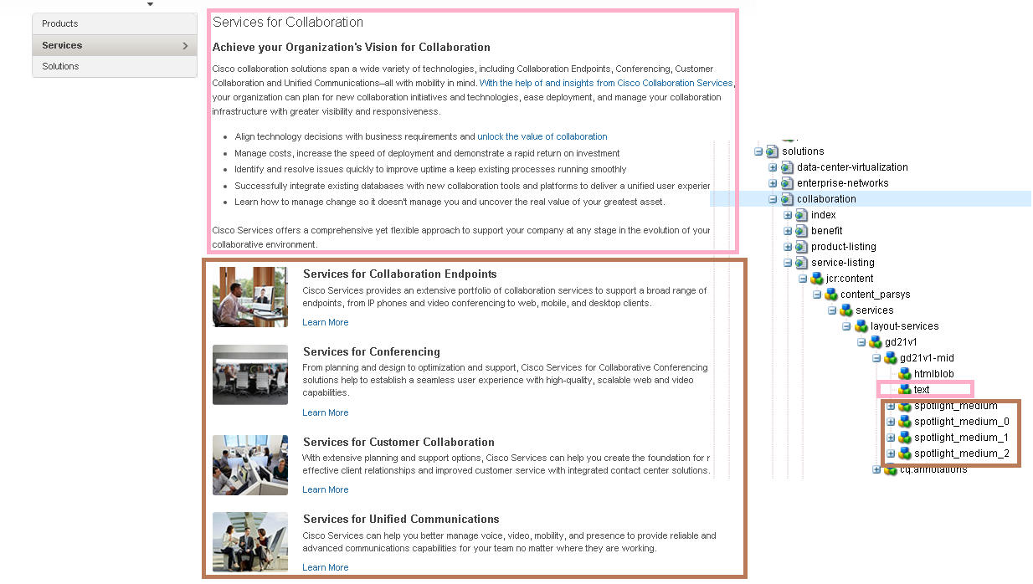
http://www.cisco.com/c/en/us/solutions/collaboration/service-listing.html
No HTML deviations in this template

